Slide 1
HCI
compendium
IUM 2024/2025

Slide 2
References
Advances in Human-Computer Interaction
H. Rex Hartson, D. Hix, edits.
Ablex Pub. corp., Norwood,
New Jersey, USA, 1992
Designing the User Interface
Ben Shneiderman
3rd Edition, Addison-Wesley, 1999
Humane Interfaces
Jef Raskin, Addison-Wesley, 2000.
Human-Computer Interaction
Alan Dix, Janet Finlay, Gregory Abowd, Russell Beale,
Prentice Hall, 3rd Edition, 2004
The Encyclopedia of Human-Computer Interaction https://www.interaction-design.org/literature/book/the-encyclopedia-of-human-computer-interaction-2nd-ed
Nielsen Norman Group https://www.nngroup.com/articles/

Slide 3
interfaces, why?
without interfaces computers would be useless
human-computer interfaces are not even as carefully designed as computer-computer interfaces
computer science has a definite role in the design of human-computer interfaces

Slide 4
interfaces, what for?
creativity is very important in the design of user interfaces
two sides of the design problem:
1) computer science issues (essentially programming a chosen set of algorithms favouring human-program communication and control) and
2) human issues (essentially exploiting and supporting user's skills)

Slide 5
formal approaches
formal approaches help in abstracting the details and subtleties of how computers are used; interface features should not be looked at within particular applications: undo in an airline reservation system but in a wide domain - undo in an interactive system
sometimes - as we proceed in the design of user interfaces for a class of applications (i.e. word processors) such applications have evolved - what has been used in the past and recent present may also be used in the near future on new applications
we have abstracted general rules (low cognitive load, few basic icons, possibility of undoing all actions, backtracking availability, on-line help, etc.)
Notes:
Undo in a Specific Application:
If we examine "undo" in the context of a specific application (such as an airline reservation system), we might get bogged down in the specific details and requirements of that application, which might not apply elsewhere.
This includes considering specific data, workflows, and user roles related to airline reservation systems.
Undo in a General Context:
Considering "undo" in a broad sense means thinking about it abstractly and formally, which could involve considering:
How it should function at a high level (e.g., reversing the previous action).
What kinds of actions should be undoable.
How to represent and store previous states of a system so they can be returned to, etc.

Slide 6
formalizing?
formalizing has its detractors: are we abstracting the user too much?
how do we capture his intentions, his expectations, his skills? To formalize, in this context, is a question-raiser more than an issue-solver
documentation: saying what is implemented and implementing what is said: high level of vision on behalf of the designers, implementors and documentors
user interface design: complexities of the human-program communication needs + peculiarities of human users: they should all be understood, modelled, taken care of, documented, tested, validated, refined...
Notes:
Designers, Implementors, and Documentors:
Designers need to ensure that the system is crafted in a way that meets user needs and expectations, considering the balance between abstraction and specificity.
Implementors (developers) must ensure that the design is faithfully translated into a functional system, adhering to the specifications and requirements set forth by the designers.
Documentors are tasked with creating comprehensive, accurate, and accessible documentation that both describes the implemented system and guides users and developers in its use and maintenance.

Slide 7
interface benefits
• enjoyment - playing games, hacking programs, communicating with others, exploration of data, composition of music/poetry/essays, listening to music, drawing/sketching, studying, etc.
• enabling new skills - augmentation ≠ enabling monitoring in a better way is an empowerment, controlling a super-jet may only be done via a special interface for the pilot
• delegation - the computer is left to do repetitive, dangerous, critical jobs which the human would not do as smoothly (a negative case arises when the user delegates full responsibility on incomplete tasks)
• safety - remote control operations to avoid dangerous locations (coal mines, radioactive stations, etc.)
Notes:
1. Enjoyment
Definition: Interfaces can be designed to provide enjoyment and pleasure to users, enhancing their overall experience.
Examples:
Playing Games: Interactive and engaging gaming interfaces.
Communicating: Facilitating social interactions through chat or video call interfaces.
Exploration and Creation: Enabling users to explore data, create music, write essays, or sketch, by providing intuitive and user-friendly tools and environments.
Importance: Enjoyable interfaces can improve user satisfaction, increase engagement, and potentially foster creativity and social interaction.
2. Enabling New Skills (Augmentation)
Definition: Interfaces can enable users to perform tasks or access capabilities beyond their inherent skills or physical abilities (augmenting their abilities).
Examples:
Monitoring: Enhanced monitoring interfaces could allow users to observe and manage complex systems more efficiently than manually.
Controlling: Specialized interfaces (like those for piloting super-jets) enable users to control complex machinery which would otherwise be inaccessible or unmanageable.
Importance: Interfaces that augment user capabilities can empower them to undertake tasks and roles that would otherwise be impossible or impractical.
3. Delegation
Definition: Interfaces allow users to delegate certain tasks to computers, often those that are repetitive, dangerous, or require precise control.
Examples:
Repetitive Jobs: Automating data entry or calculations.
Dangerous/Critical Jobs: Managing systems or processes that may be hazardous if done manually.
Negative Case: Delegating too much or relying heavily on automated systems, especially for tasks that are not fully understood or mapped out, can lead to errors or unintended consequences.
Importance: By allowing users to delegate tasks to computers, interfaces can increase efficiency, reduce human error, and improve safety.
4. Safety
Definition: Interfaces can facilitate remote control or management of systems, allowing users to perform tasks from safe locations.
Examples:
Remote Operations: Controlling machinery or accessing data from remote locations, preventing the need for physical presence in potentially dangerous environments like mines or radioactive stations.
Importance: Interfaces that allow for remote operation enhance safety by enabling users to perform risky tasks from a distance, protecting them from physical harm.

Slide 8
more benefits
development - cultural enrichment through interactive teaching programs: arithmetic drill, road signals for car driving, language practice, etc.
• doing things at once - many different stages of a job were done in sequence, for each mistake corrections had to be done everywhere (as in a presentation, course preparation, etc.) a presentation manager (like Power Point) manages slides, notes, outlines together with timings, transitions, colours, backgrounds, etc.
• computing - what computers were born for! integrate, plot, enhance an image, prove a theorem, compute a spacecraft trajectory, etc.

Slide 9




interaction technology: a chronology
On/Off >‘48
Data input >‘55
Data input on request >‘65
Graphical input via light pen, mouse >‘72
Menu selection >‘78
Mac Style (desktop metaphor) >‘83
Multimedia tools >‘90
Multimodal tools >‘94
Internet tools & services > 00
12...3
4..92
New Folder �N

Slide 10
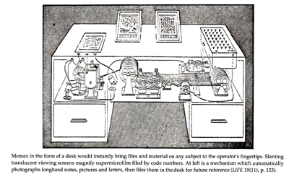
Envisioning the future in 1945
A Memex is a device in which an individual stores all his books, records, and communications, and which is mechanized so that it may be consulted with exceeding speed and flexibility. It is an enlarged intimate supplement to his memory. (Bush, 1945, 12)

Slide 11
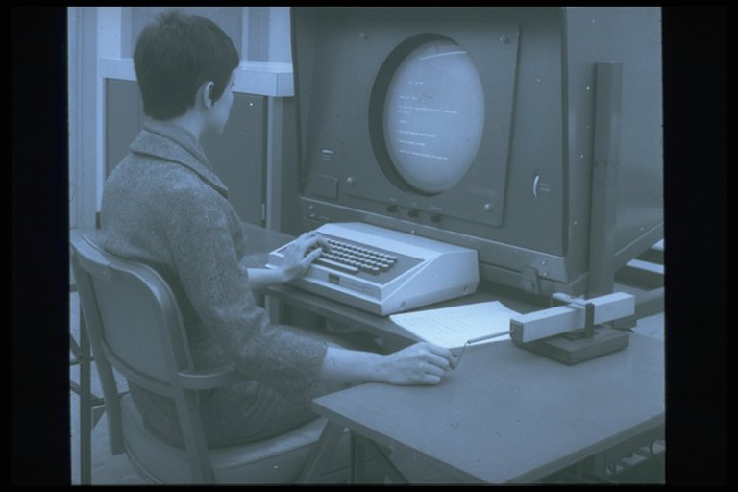
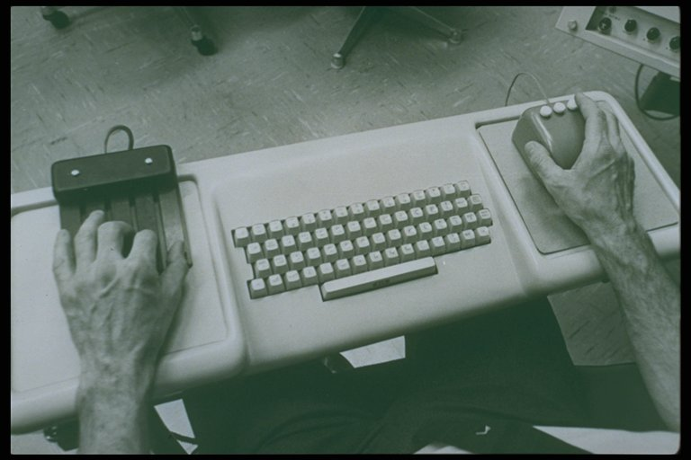

Douglas Engelbart
Human Augmentation System
The Mother of All Demos: https://www.youtube.com/watch?v=yJDv-zdhzMY
Ergonomic Keyboard
Console
First Mouse
NLS Mouse and
workstation

Slide 12
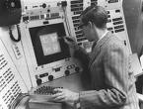
Ivan Sutherland
The Ultimate Display – Ivan Sutherland
The ultimate display would, of course, be a room within which the computer can control the existence of matter. A chair displayed in such a room would be good enough to sit in. Handcuffs displayed in such a room would be confining, and a bullet displayed in such a room would be fatal. With appropriate programming such a display could literally be the Wonderland into which Alice walked. (Sutherland, 1965, 508)
Sketchpad

Slide 13
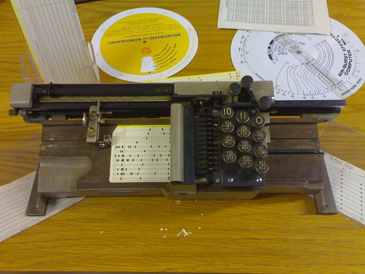
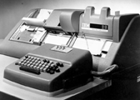
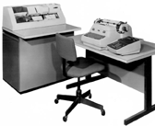
Large Scale Computing
They were programmed using punch cards
Time-sharing services (TSSs) were schemes that used the downtime of one user for another user who was currently active.
Manual card punch machine
IBM card punch machines.
Courtesy IBM Corporate Archives.
Notes:
Mainframe Era:
In the era of mainframe computers, resources were scarce and expensive.
Time-sharing was introduced as a way to maximize resource utilization and allow multiple users to interact with a single mainframe computer.
Remote Access:
Users could access the mainframe remotely through terminals, enabling them to utilize its computational capabilities without having direct physical access.

Slide 14
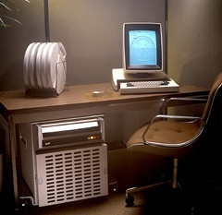
Personal Computing
Desktop Computing
The Alto, developed at the Xerox Palo Alto Research Center in 1973, was the first computer to use a GUI that involved the desktop metaphor: pop-up menus, windows, and icons
The Xerox Alto computer (1973)
Courtesy Palo Alto Research Center.

Slide 15
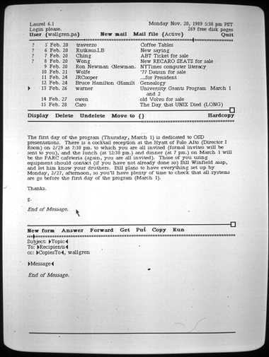
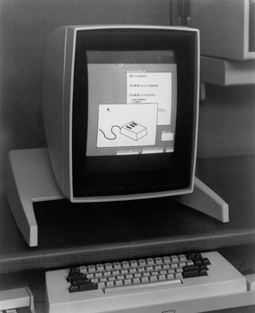
Personal Computing
The Xerox Alto mail program (1973)
The Xerox Alto computer (1973)

Slide 16
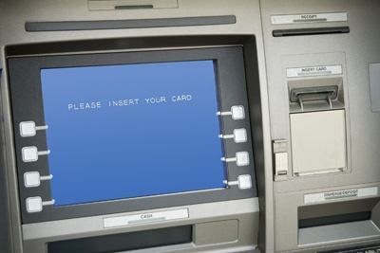
Personal Computing
Personal-Public Computing
Public Access Computing – The information divide
Public Information Appliances
Automated teller machine with touchscreen.
Courtesy BigStockPhoto.com
Notes:
The Information Divide:
Often refers to the disparity between individuals who have access to information and communication technology and those who do not (also known as the digital divide).
Public access computing aims to bridge this divide by providing accessible computing resources to individuals who might not have access otherwise.

Slide 17
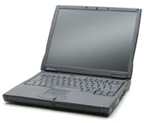



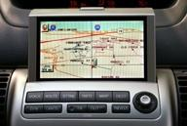
Mobile Computing
Desktop metaphors do not translate well to mobile devices.
Hybrid desktop/mobile environments can afford optimal interaction efficiency.
MP3 player
Laptop computer
Tablet computer
Cell phone
On-board navigation system
Courtesy BigStockPhoto.com

Slide 18
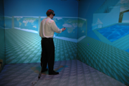
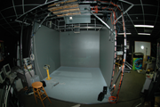
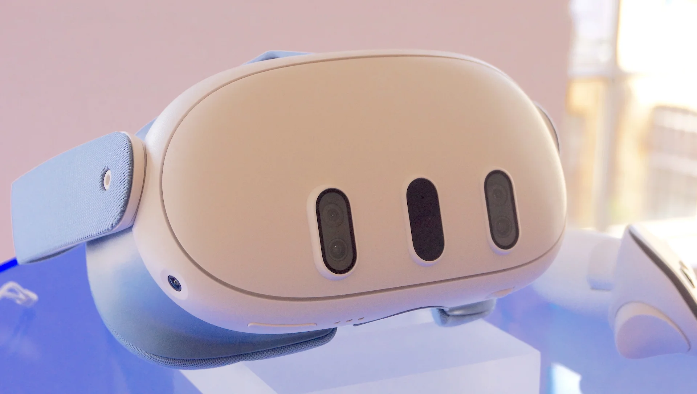
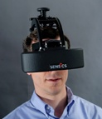
Virtual Reality - Immersive
CAVE automated virtual environment at the National Center for Supercomputing
Applications (NCSA).
http://brighton.ncsa.uiuc.edu/~prajlich/cave.html
Sketching a virtual world in the
VR design tool ShadowLight.
Photographs and ShadowLight application courtesy of Kalev Leetaru.
Sensics piSight
Virtual Reality (VR) system.
http://www.sensics.com/
Meta Quest 3 https://www.meta.com/it/quest/quest-3/

Slide 19
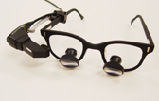
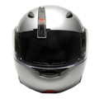
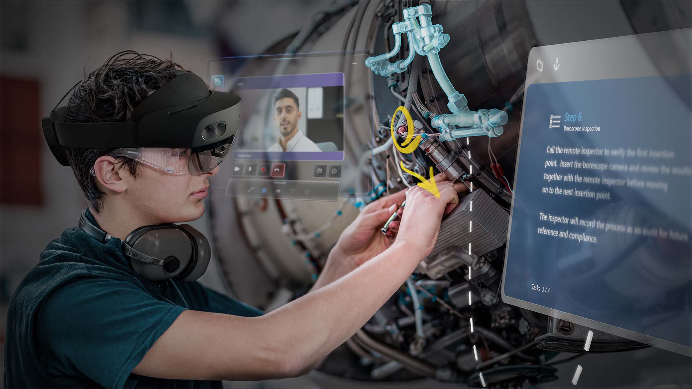
Augmented Reality
AR I/O devices
Heads Up Displays (HUD)
Optical see through
Video see through
MicroOptical MD-6
Critical Data Viewer.
http://microoptical.net/
Microsoft Hololens 2
https://www.microsoft.com/it-it/hololens
Sportvue MC1 motorcycle helmet
heads-up display.
http://www.sportvue.com/

Slide 20
Computer Science vs Web Science
CS
WS
Sir Tim Berners-Lee - 2007
Metrics
Moore’s Law
Order (n) algor.
Gigabytes
page visits
visitor/month
# songs/video

Slide 21
CS vs WS:
CS
WS
Subjects
Computer networks
Packet exchange
Information
Programming languages
Databases, operating systems
Compilers
3D Graphics, rendering algos
Computational geometry
social networks
voice over IP, musical sharing
relationships
Wikis, blogs, tags, fotologs
E-government, E-learning
Medical Info medica, business
Map creation and sharing
Animation, music, foto, videoclips

Slide 22
CS vs WS:
CS
WS
Focus
Technology
Computers
Supercomputers
Efficient programming
Applications
Users
Mobile devices
Universal Usability

Slide 23
computer or interface? (I)
productivity - the user interface is vital here, the quality of interaction and ease of action can be greatly enhanced through a good user interface
managing complexity - typically in air flight control for landing and take-off, a single operator can do much more work (in better conditions) if he has a good user interface
reliability - programs may run many times in exactly the same way (they never get tired), in some instances they may be too inflexible...

Slide 24
computer or interface? (II)
quality - programs may achieve greater quality, accuracy and reproducibility than humans and this comes from the computer technology and not from the user interface
security - the interface may check the user's authority to employ certain programs, record past transactions (financial operations, etc.), inventory accounting, etc.

Slide 25
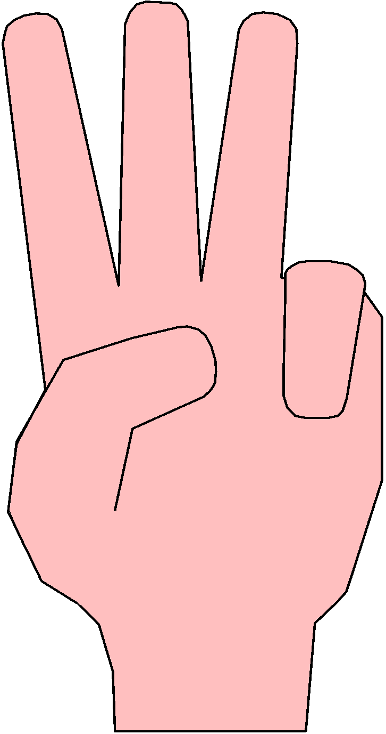
Communicating Channels
COMPUTER
C-networking
TEXT
PICTURES
SOUNDS
GESTURES
DIRECT
ANALYSIS
SYNTHESIS
BODY LANGUAGE
WRITING
SPEAKING
PR & IP
SIGN LANGUAGE
DRAWING &
SKETCHING
IMAGE DOCUMENT
SCENE ANALYSIS
VISUAL PROGRAMMING
Scientific Visualization
Algo Animation
OCR
SW Visualization
Code Animation
Visual Query
Systems
Spreadsheet
Process Visualization
Dev. Environment
Data Animation

Slide 26
how to design together
with the new possibilities in computer-supported communication shared thinking is now possible
within user interface design: how do designers communicate with users?
what kind of user-model do they have in mind?
which information is passing from one community to the other? data and control, information contents and pragmatics (on the user of the information within a given environment)
to some users (with special needs) the computer and its interface may help extend their range of activities or (inverting all the benefits listed before) reduce job satisfaction

Slide 27
approaches to design
User interface design requires the cooperation of computer scientists and psychologists for a good understanding of algorithms and programs (computer side) and people (user side)
two approaches arise:
1) where computer scientists want to have a well designed interface after a first shot - using formal design rules - and
2) where psychologists would like an iterative design in order to gradually improve the developed system.

Slide 28
incompatibility
when computers cannot be interfaced, we say they are "incompatible"
when humans and computers cannot communicate we never refer to incompatibility although this is the case
do interactive programs aim at special user features?
better design: user centered - even user co-author
...to switch off Windows you have to choose the start-up icon!

Slide 29
observations
treat people at least as well as we already treat computers
is too easy to ignore important design issues
designers tend to overcome bugs by adding ad-hoc features, extending the systems and making them more complex
conflicts and limitations in the original design can be camouflaged with local add-ons
new features are unrelated, may have side-effects and no accurate forecast of what may happen to other actions performed through the new interface
typically, designs grow bottom-up by accruing features

Slide 30
Composition Fallacy
properties of the parts are also properties of the whole
(composition)
a good interface may have bad parts
good parts may exist within a bad interface

Slide 31
abstraction
user is the participant with a choice - any kind of participant - naive, expert, discretionary, disabled, etc.
computer is the participant with a program - it obeys instructions
designer the participant who anticipates the possible choices of the user encoding them into a computer program
pragmatically, many different persons participate to the design of computer systems: manager, programmer, analyst, technical author, evaluator and user

Slide 32
interaction
humans understand through modelling
computer users build up their own models of the systems they will be using
constant activity helps to achieve tasks even if not all the details are known provided there are no side effects
user
computer
designer

Slide 33
communication bandwidth
user
computer
designer

Slide 34
design information
user
computer
designer
participation in design
task
task description

Slide 35
mental models & programs
additional information comes from
on the user's side - mental models and
on the computer's side - programs but...
mental models and programs are not equivalent!
they are not isomorphic
not synchronized
use different logical systems
have different bugs and limitations.

Slide 36
programs and mental models
if they were equivalent, one of them would be sufficient
either the mental model or the program
the program may be run and turns useful if, in some way, it matches the mental model
every computer system has been built on the basis of explicit or implicit models of the use
of his/her tasks/needs/expectations
generally a canonical (according to a formula) model of the user is employed by the designer

Slide 37
improvements
HC-interaction may be improved by
increasing the coherence between the mental model and the canonical model
decreasing the reliance on that coherence
increasing the information capacity of the interface

Slide 38
bottlenecks
information transfer bottlenecks (I/0)
information processing bottlenecks (mental)
computer
user
designer

Slide 39
modelling
to think effectively about certain aspects of the thing being modelled
metacircular modelling - at some stage one must understand the model itself which requires another model and this may last indefinitely...nevertheless this feature may be turned into a positive one
loss of representation - we trade abstracting with a better grasp of other aspects of the design which holds whenever we want to concentrate on correctness, efficiency, efficacy or any well-defined property

Slide 40
modelling +
if we care about usability this approach may not help
the holist criterion claims that modeling loses issues of crucial importance, the whole system has properties that are not present in any of the parts being modeled
the Turing hierarchy - a model powerful enough to work interactively should be Turing Complete so as to model anything a Turing Machine could model: what can we learn about such a system?
phenomenalist alternative - even if thinking with a model in mind, we are engaged in activity, theories/models may be alternatively be substituted by actions (phenomena) and we may think on those terms
Notes:
A model that is Turing Complete can be extremely powerful in terms of the computational processes it can represent and simulate. (a system or programming language that has the ability to perform any computation that can be described algorithmically. In other words, a Turing complete system can simulate a Turing machine, which is a theoretical model of computation devised by Alan Turing.)
However, Turing Completeness does not necessarily provide insights into other aspects, like usability, efficiency, or the emergent properties of a system.

Slide 41
projection and transference
to reveal a model - often subconscious - by projection: the user interacts with a system and detects motives for wanting the model to be in such a particular way - yet the model is not easy to be fully described and therefore used by the designer
in transference the user projects another model - not his own - one of other users (parents, teachers, etc.) the interface is locked in a discourse rehearsed in the past for instance with other systems...
Notes:
Projection in Psychology:
In psychology, projection is a defense mechanism where individuals attribute their own thoughts, feelings, and motives to another person. It's a way of coping with one's own uncomfortable or unacceptable thoughts or emotions by attributing them to someone else.
Application to HCI:
Projection might occur when a user interacts with a system and detects or interprets motives or intentions in the system's design that reflect the user's own subconscious thoughts or desires.
The user may project their own expectations, preferences, or beliefs onto the system, assuming that the system's design aligns with their personal model or perspective.
Transference in Psychology:
Transference refers to the unconscious redirection of feelings and attitudes from one person to another, often based on past experiences or relationships. This can involve projecting feelings or attitudes associated with one person onto someone else.
Application to HCI:
In a computational context, transference might occur when a user projects the model, expectations, or behaviors of other individuals from their past onto their interaction with a system.
For example, a user might interact with a system and unconsciously apply behaviors or expectations learned from their parents, teachers, or past experiences with other systems.

Slide 42
non-determinism
randomness may be requested but generally is a non-wanted situation: bugs - they come from unexpected external situations, including the user
computer programs should be predictable, if the user has no adequate model for a situation, it may appear random
a particular interference from the real world is the one of time, real-time races are performed whenever decisions are made depending on which information arrives first
a schedule for erasing old files should be known otherwise those files exceeding the time threshold will be removed and this may appear random to the user
non-determinism may appear just because some information is not known - note-takers, diaries, transcripts help to "keep track"

Slide 43
user
difficult to maintain consistent beliefs - along time
not using an adequate notation
typically wanting transitive preferences (A better than B better than C/ implies A better than C)
menu interface better than command-based one
knowledge-based direct manipulation better than menu
Notes:
1. Difficult to Maintain Consistent Beliefs Over Time
User Perspective:
Users may find it challenging to maintain consistent beliefs or preferences when interacting with systems over time.
This can be due to changing needs, evolving understanding of the system, or varying contexts in which the system is used.
Design Consideration:
Designers should anticipate that user beliefs and preferences might change and aim to create systems that can adapt to these shifts in user behavior and expectations.
2. Not Using an Adequate Notation
Notation in User Interfaces:
Adequate notation in user interfaces refers to the use of symbols, icons, or visual elements that are clear, intuitive, and easily understood by users.
Inadequate notation can lead to confusion and difficulties in interacting with the system.
Design Focus:
Designers should prioritize the use of clear and intuitive notations in user interfaces to ensure that users can easily understand and interpret the information presented.
3. Preference for Transitive Preferences
Transitive Preferences:
Transitive preferences refer to the idea that if a user prefers option A to option B and option B to option C, then they should also prefer option A to option C.
User Expectations:
Users often prefer systems where their preferences are transitive, as it simplifies decision-making and makes it more predictable.
Design Implication:
Designing systems with clear and consistent feedback on user choices can help users maintain transitive preferences and make informed decisions.
4. Menu Interface Better Than Command-Based One
Menu vs. Command-Based Interface:
Many users prefer menu-based interfaces over command-based ones. Menu interfaces present options in a structured, visual format that is often more intuitive and less error-prone.
User-Friendly Design:
Designers should consider the user-friendliness of menu interfaces, as they can make it easier for users to access and select options without needing to remember specific commands.
5. Knowledge-Based Direct Manipulation Better Than Menu
Knowledge-Based Direct Manipulation:
Knowledge-based direct manipulation refers to interfaces where users can directly interact with objects, data, or elements in a way that aligns with their existing knowledge and expectations.
Advantages:
Users often find knowledge-based direct manipulation interfaces more intuitive and user-friendly compared to menu-based interfaces.
These interfaces allow users to interact with the system in a way that matches their mental model, making them more efficient and effective.

Slide 44
short-term memory
selective attention, shifting attention = 50 ms, eye movements 200 ms, audio is captured quickly and faster than video
once selected, the information is copied in STM: a conscious place which may manage 7 objects, if unused the contents of STM decays after 20" - it can be refreshed by rehearsal
data is stored in chunks each one being a name related to an object, the chunks (output chunks are routines) may contain sub-chunks which may be stored and processed
chunks are built by closure, STM may be seen as a memory stack, the closure is a pop operation
Notes:
“Selective attention” refers to the brain’s ability to focus on a specific stimulus while ignoring others.
“Shifting attention” is the process of moving one’s focus from one stimulus to another. Chunks are built by closure, which means that when a chunk is created, it is closed off from other information in STM. This can be useful for preventing interference from other information in STM.

Slide 45
on closure
closure may eclipse other goals - this may cause a termination error caused by a 'too effective closure'
in a cash dispenser if the money is provided AFTER the card has been returned, the user will never forget his card in the machine (termination error)
resource limited: too many processes to be looked at are happening
data limited: darkness for eyesight
these features are important in the design of warning/help clues within interfaces

Slide 46
long-term memory
> 5" the contents of STM gets transferred in LTM having a large capacity and small decay
our knowledge on language is contained in LTM: it is 'perfect' only sometimes it is difficult to retrieve - particularly without rehearsal - whenever successful it takes .1 "
mnemonics helps to retrieve wanted data, previous rehearsal in STM also helps: I could insert my table on ≠ behaviours of people and machines during interaction
people can never forget, computers may completely erase data and sometimes users forget this...

Slide 47
l-tm & s-tm
both suffer from interference since different items in memory may have the same coding (as if Hash coded) - it becomes hard to recall one thing since it was recorded with two different codes, or the same code for two different items
for 2 different interactive systems, the experience of the first, carries-over the learning process of the second if they are similar - as when programming with a new language/speaking a new language in terms of an older, known one (conceptual capture)

Slide 48
on behaviour
example of priming: impinging an idea into someone - spell "shop"- what do you do when you see a green light? (go and not stop)
stereotyped behaviour is when people panic and use a "default escape" solution that generally is not the best action to perform under the circumstances - people may make mistakes in this way and, even worse, are not able to recover from such mistakes...
Notes:
Priming: watching for some time the yellow color, makes it easier to recall yellow objects (lemons, bananas, etc.)
Remember that recent research has shown that priming (and generally, bias) effects could be statistical effects of those researches. So take it with a grain of salt.

Slide 49
cognitive dissonance
Festinger, 1957
after a (program) choice is made, the new alternative looks worse than the other, possible one, and...vice versa.
humans try to reduce such dissonance to feel better - e.g. the user may change his program, reduce the importance of choice (his job is more significant than the program he is using), add further consonant ideas, selectively expose himself to read positive evaluations of his choice...(tricks that help)
Notes:
Cognitive dissonance refers to the psychological discomfort that arises when a person holds conflicting beliefs, attitudes, or makes choices that are inconsistent with their existing values or beliefs.
In the context of human-computer interaction, cognitive dissonance might manifest as follows:
Choice Dissonance: After a user makes a choice, they may experience discomfort if they perceive the alternative options as more attractive or better. This can lead to feelings of regret or uncertainty about the chosen option.
Coping Mechanisms: To reduce cognitive dissonance and feel better about their choice, users may employ various coping mechanisms. Some of these mechanisms can include:
Changing the Program: Users may switch to a different program or option to alleviate the discomfort.
Reducing Importance: Users might downplay the significance of the choice they made, telling themselves that their job is more important than the software they use, for example.
Adding Consonant Ideas: Users might seek out information or arguments that support their choice to reinforce their belief that it was the right decision.
Selective Exposure: Users may deliberately expose themselves to positive feedback or evaluations of their choice while avoiding negative reviews or criticisms.

Slide 50
users adapt
it is easier to stay with nonsense, than face the cost of changing over to something which would almost certainly be better
a user will adapt, and then the designer will continue with the same choice he made in the previous design

Slide 51
homeostasis
users take risks depending on their assessment of the consequences of their actions
if the interactive system is safe, they will behave wildly, if the system is simple they will try complex things
i.e. the user style will depend on his attitudes as well as on the documentation of the system - homeostasis makes designers build systems far more complex than necessary
Hawthorne Effect (Mayo 1933) : users tend to work harder if they are participating to something new or where they have more control, so partly invalidating the experiment
Notes:
Homeostasis: Homeostasis refers to the tendency of systems, including interactive systems, to maintain stability or balance. In the context of design, it means that designers may unintentionally make systems more complex than necessary to maintain a certain level of equilibrium.
Complexity and Balance: Designers might add complexity to a system in an attempt to address various user needs, maintain user interest, or balance competing design requirements. However, excessive complexity can lead to usability issues and confusion.
Hawthorne Effect (Mayo 1933): This concept refers to the phenomenon where individuals change their behavior when they are aware they are being observed. In the context of user interaction with systems, users might work harder or behave differently when they know they are participating in something new or when they have more control.

